Slide 1
OBJECT ORIENTED PROGRAMMING Database Connectivity with JDBC:
Prepared by
Dr. Abinash Tripathy
School of Computer Application
KIIT Deemed to be University, Bhubaneswar

Slide 2
Java JDBC
JDBC stands for Java Database Connectivity. JDBC is a Java API to connect and execute the query with the database.
It is a part of JavaSE (Java Standard Edition).
JDBC API uses JDBC drivers to connect with the database. There are four types of JDBC drivers:
JDBC-ODBC Bridge Driver,
Native Driver,
Network Protocol Driver, and
Thin Driver
Before JDBC, ODBC API was the database API to connect and execute the query with the database. But, ODBC API uses ODBC driver which is written in C language (i.e. platform dependent and unsecured). That is why Java has defined its own API (JDBC API) that uses JDBC drivers (written in Java language).
We can use JDBC API to handle database using Java program and can perform the following activities:
Connect to the database
Execute queries and update statements to the database
Retrieve the result received from the database.

Slide 3
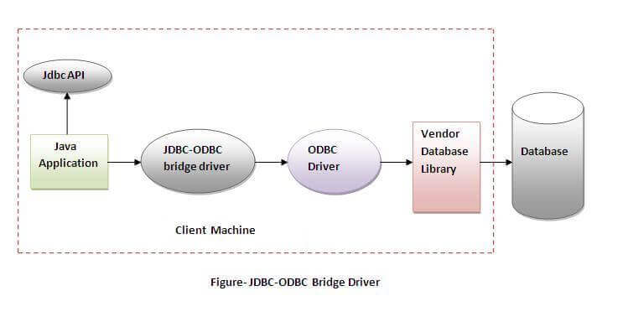
JDBC-ODBC bridge driver
The JDBC-ODBC bridge driver uses ODBC driver to connect to the database.
The JDBC-ODBC bridge driver converts JDBC method calls into the ODBC function calls.
This is now discouraged because of thin driver.
Oracle does not support the JDBC-ODBC Bridge from Java 8. Oracle recommends that you use JDBC drivers provided by the vendor of your database instead of the JDBC-ODBC Bridge.

Slide 4
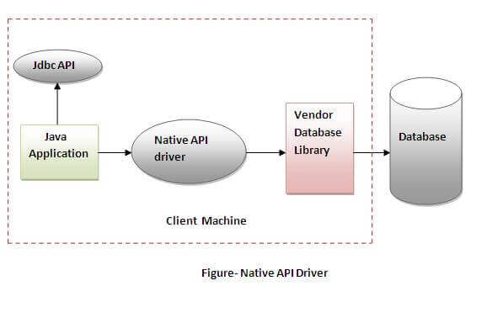
Native-API driver
The Native API driver uses the client-side libraries of the database.
The driver converts JDBC method calls into native calls of the database API.
It is not written entirely in java.

Slide 5
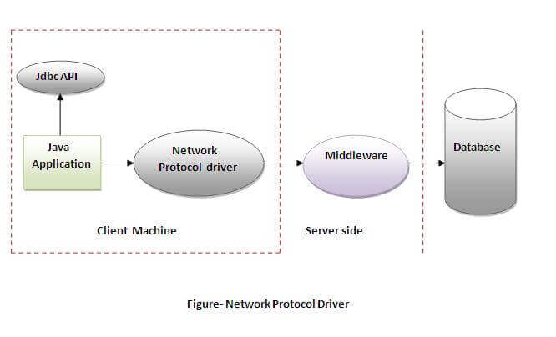
Network Protocol driver
The Network Protocol driver uses middleware (application server) that converts JDBC calls directly or indirectly into the vendor-specific database protocol.
It is fully written in java.

Slide 6
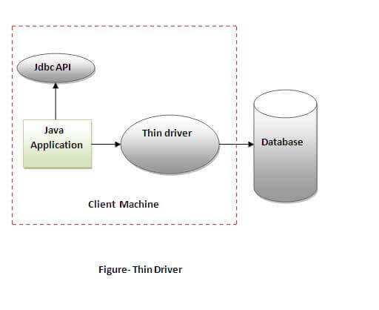
Thin Driver
The thin driver converts JDBC calls directly into the vendor-specific database protocol.
That is why it is known as thin driver. It is fully written in Java language.

Slide 7
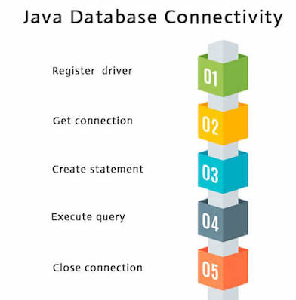
Java Database Connectivity
There are 5 steps to connect any java application with the database using JDBC. These steps are as follows:
Register the Driver class
Create connection
Create statement
Execute queries
Close connection

Slide 8
Register the driver class
The forName() method is used to register the driver class.
This method is used to dynamically load the driver class.
Syntax of forName() method
public static void forName(String className)throws ClassNotFoundException
2. Register the OracleDriver class
Here, Java program is loading oracle driver to establish database connection.
Syntax
Class.forName("oracle.jdbc.driver.OracleDriver");
3. Create the Statement object
The createStatement() method of Connection interface is used to create statement.
The object of statement is responsible to execute queries with the database.
Syntax
public Statement createStatement()throws SQLException
Example
Statement stmt=con.createStatement();

Slide 9
4. Execute the query
The executeQuery() method of Statement interface is used to execute queries to the database.
This method returns the object of ResultSet that can be used to get all the records of a table.
Syntax
public ResultSet executeQuery(String sql)throws SQLException
Example
ResultSet rs=stmt.executeQuery("select * from emp");
while(rs.next()){
System.out.println(rs.getInt(1)+" "+rs.getString(2)); }
5. Closing the connection
By closing connection object statement and ResultSet will be closed automatically.
The close() method of Connection interface is used to close the connection.
Syntax
public void close()throws SQLException
Example
con.close();

Slide 10
Java Database Connectivity with Oracle
To connect java application with the oracle database, we need to follow 5 following steps. In this example, we are using Oracle 10g as the database. So we need to know following information for the oracle database:
Driver class: The driver class for the oracle database is oracle.jdbc.driver.OracleDriver.
Connection URL: The connection URL for the oracle10G database is jdbc:oracle:thin:@localhost:1521:xe where
jdbc is the API,
oracle is the database,
thin is the driver,
localhost is the server name on which oracle is running, we may also use IP address, 1521 is the port number and XE is the Oracle service name.
3. Username: The default username for the oracle database is system.
Password: It is the password given by the user at the time of installing the oracle database.
Create a table: Before establishing connection, we have to create a table in oracle database.

Slide 11
Statement interface
The Statement interface provides methods to execute queries with the database.
The statement interface is a factory of ResultSet i.e. it provides factory method to get the object of ResultSet.
The important methods of Statement interface are as follows:
1) public ResultSet executeQuery(String sql): is used to execute SELECT query. It returns the object of ResultSet.
2) public int executeUpdate(String sql): is used to execute specified query, it may be create, drop, insert, update, delete etc.
3) public boolean execute(String sql): is used to execute queries that may return multiple results.

Slide 12
In this example, we are connecting to an Oracle database and getting data from employees table. Here, system and system are the username and password of the Oracle database.
import java.sql.*;
class OracleCon{
public static void main(String args[]){
try{
//step1 load the driver class
Class.forName("oracle.jdbc.driver.OracleDriver");
//step2 create the connection object
Connection con=DriverManager.getConnection(
"jdbc:oracle:thin:@localhost:1521:xe","system","system");
//step3 create the statement object
Statement stmt=con.createStatement();
//step4 execute query
ResultSet rs=stmt.executeQuery("select * from employees");
while(rs.next())
System.out.println(rs.getInt(1)+" "+rs.getString(2)+" "+rs.getString(3));
//step5 close the connection object
con.close();
}catch(Exception e){ System.out.println(e);}
}
}
C:\java\lab> javac OracleCon.java
C:\java\lab>java OracleCon
100 Steven King
101 Neena Kochhar
102 Lex De Haan
103 Alexander Hunold
104 Bruce Ernst
105 David Austin
106 Valli Pataballa
107 Diana Lorentz
108 Nancy Greenberg
109 Daniel Faviet
110 John Chen
111 Ismael Sciarra
112 Jose Manuel Urman
113 Luis Popp
114 Den Raphaely

Slide 13
// insert to table
import java.sql.*;
class OracleCon1{
public static void main(String args[]){
try{
//step1 load the driver class
Class.forName("oracle.jdbc.driver.OracleDriver");
//step2 create the connection object
Connection con=DriverManager.getConnection(
"jdbc:oracle:thin:@localhost:1521:xe","system","system");
//step3 create the statement object
Statement stmt=con.createStatement();
System.out.println (" \n\n Table before insertion\n \n");
//step4 execute query
ResultSet rs=stmt.executeQuery("select * from staff");
while(rs.next())
System.out.println(rs.getInt(1)+" "+rs.getString(2)+" "+rs.getString(3)+ " "
+rs.getString(4)+ " " +rs.getInt(5));
// insert into table
int x =stmt.executeUpdate("insert into staff values (5,'java','lab', 'kiit',18000)");
System.out.println (" \n\n Table after the insertion\n \n");
// display updated values
ResultSet rs2=stmt.executeQuery("select * from staff");
while(rs2.next())
System.out.println(rs2.getInt(1)+" "+rs2.getString(2)+" "+rs2.getString(3)+ " "
+rs2.getString(4)+ " " +rs2.getInt(5));
//step5 close the connection object
con.close();
}catch(Exception e){ System.out.println(e);}
}
}

Slide 14
C:\java\lab>javac OracleCon1.java
C:\java\lab>java OracleCon1
Table before insertion
1 Sachin Mishra Mumbai 1500
2 Virat Das Delhi 12000
3 abc Das BBSR 10000
4 LMN PQR KOLKATA 13000
Table after the insertion
1 Sachin Mishra Mumbai 1500
2 Virat Das Delhi 12000
3 abc Das BBSR 10000
4 LMN PQR KOLKATA 13000
5 java lab kiit 18000

Slide 15
// Delete from the table
import java.sql.*;
class OracleCon2{
public static void main(String args[]){
try{
//step1 load the driver class
Class.forName("oracle.jdbc.driver.OracleDriver");
//step2 create the connection object
Connection con=DriverManager.getConnection(
"jdbc:oracle:thin:@localhost:1521:xe","system","system");
//step3 create the statement object
Statement stmt=con.createStatement();
System.out.println (" \n\n Table before deletion\n \n");
//step4 execute query
ResultSet rs=stmt.executeQuery("select * from staff");
while(rs.next())
System.out.println(rs.getInt(1)+" "+rs.getString(2)+" "+rs.getString(3)+ " "
+rs.getString(4)+ " " +rs.getInt(5));
// delete from table
int x =stmt.executeUpdate("delete from staff where staff_id = 5");
System.out.println (" \n\n Table after the deletion\n \n");
// display updated values
ResultSet rs2=stmt.executeQuery("select * from staff");
while(rs2.next())
System.out.println(rs2.getInt(1)+" "+rs2.getString(2)+" "+rs2.getString(3)+ " "
+rs2.getString(4)+ " " +rs2.getInt(5));
//step5 close the connection object
con.close();
}catch(Exception e){ System.out.println(e);}
}
}

Slide 16
C:\java\lab>javac OracleCon2.java
C:\java\lab>java OracleCon2
Table before deletion
1 Sachin Mishra Mumbai 1500
2 Virat Das Delhi 12000
3 abc Das BBSR 10000
4 LMN PQR KOLKATA 13000
5 java lab kiit 18000
Table after the deletion
1 Sachin Mishra Mumbai 1500
2 Virat Das Delhi 12000
3 abc Das BBSR 10000
4 LMN PQR KOLKATA 13000

Slide 17
// create, insert and display from the table
import java.sql.*;
class OracleCon3{
public static void main(String args[]){
try{
//step1 load the driver class
Class.forName("oracle.jdbc.driver.OracleDriver");
//step2 create the connection object
Connection con=DriverManager.getConnection(
"jdbc:oracle:thin:@localhost:1521:xe","system","system");
//step3 create the statement object
Statement stmt=con.createStatement();
//step4 execute query
boolean b=stmt.execute("create table student1(s_id number, first_name varchar(100),last_name varchar(100),marks number)");
// insert into table
int x =stmt.executeUpdate("insert into student1 values(1,'abc','def',90)");
// display updated values
ResultSet rs2=stmt.executeQuery("select * from student1");
while(rs2.next())
System.out.println(rs2.getInt(1)+" "+rs2.getString(2)+" "+rs2.getString(3)+ " "
+rs2.getString(4));
//step5 close the connection object
con.close();
}catch(Exception e){ System.out.println(e);}
}
}
C:\java\lab>javac OracleCon3.java
C:\java\lab>java OracleCon3
1 abc def 90

